Slide 1
THE DOMAINS OF BUSINESS AGILITY THE ORGANIZATIONAL "MUSCLES" NEEDED TO BUILD BUSINESS AGILITY

Slide 2
To see how these slides can be used and the narrative I use with these slides please watch:
https://youtu.be/rLqozl2lmGk

Slide 3
Permissions
The intent for sharing this material is to allow you to use and adapt these slides to help you explain the Domains of Business Agility. Please feel free to use and / or modify these slides as needed. I have also included some light speaker notes to help you. Please keep the attribution on the slides.

Slide 4
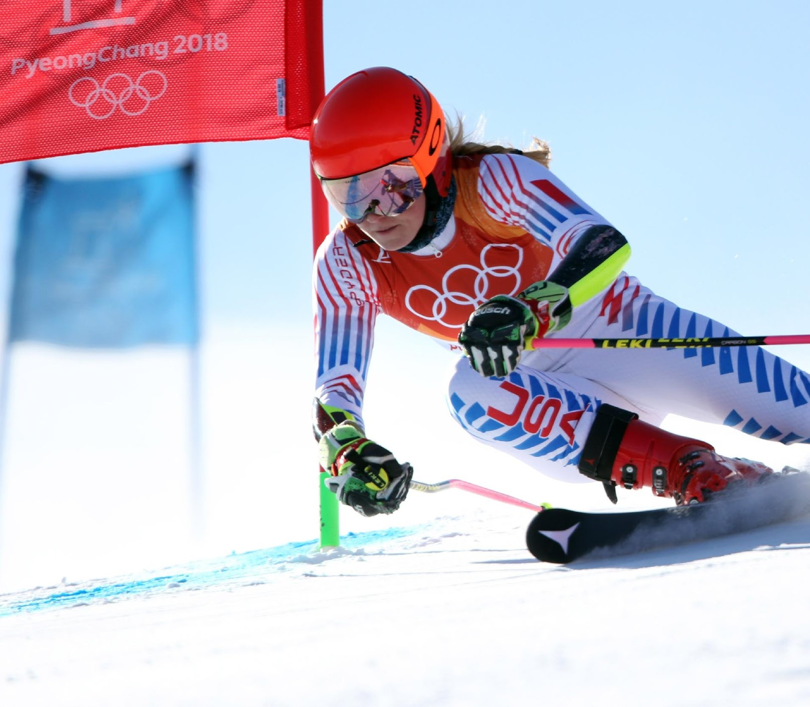
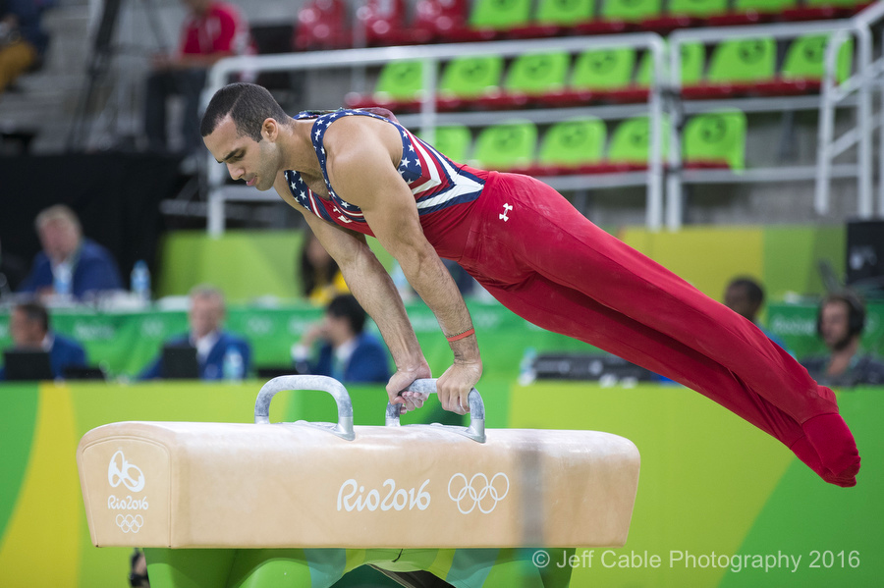
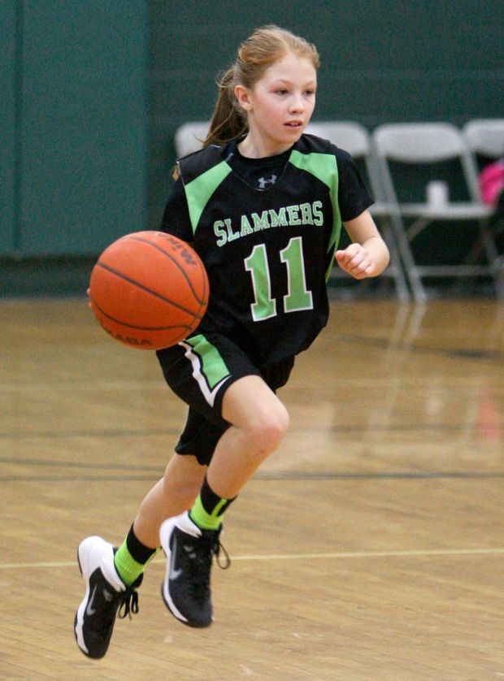
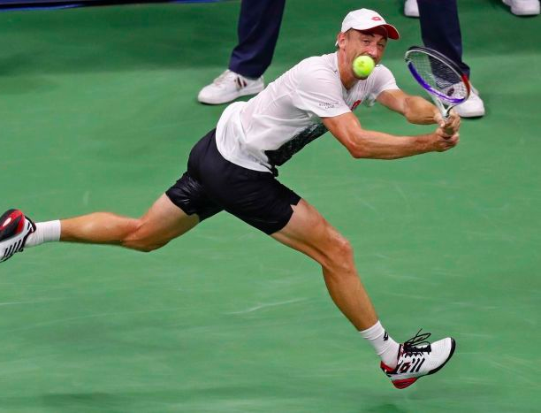
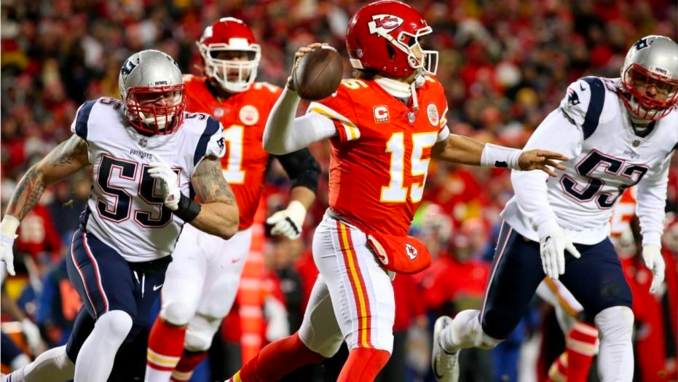
Notes:
Introduce the metaphor:
Business Agility is like sports / fitness / athletic performance
Business Agility – similar to sports / fitness / athletic performance – is not something you have or don’t have – its not a destination you reach and you are done – it is something that you attain more of when you intentionally invest in it and when you stop investing in it it will go away and decrease.
Business Agility – similar to sports / fitness / athletic performance – requires deliberate effort towards mastery, unrelenting discipline, and is open to anyone [any company] regardless of age, gender [structure], or sport [industry].

Slide 5
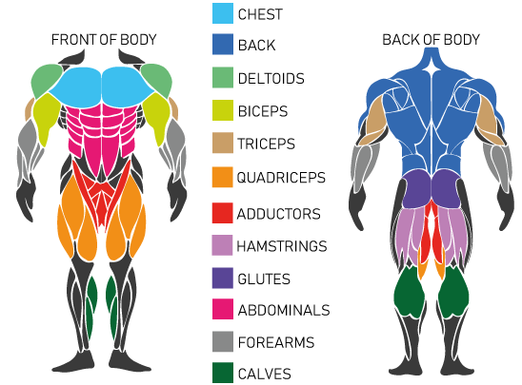
Notes:
Like an athlete needs to understand what muscles she/he need to work on [for an intended purpose], and then create workouts to get better, similarly companies pursing Business Agility need to understand what ”muscles” they need to work on – to build a specific capability for the organization.

Slide 6
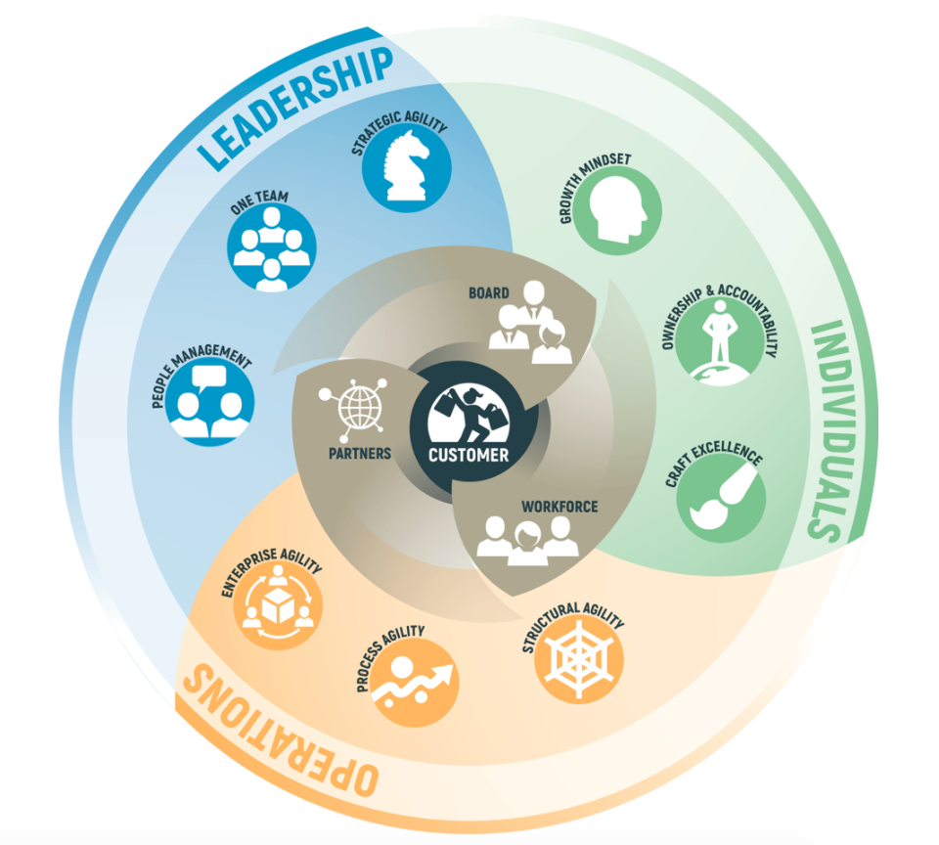
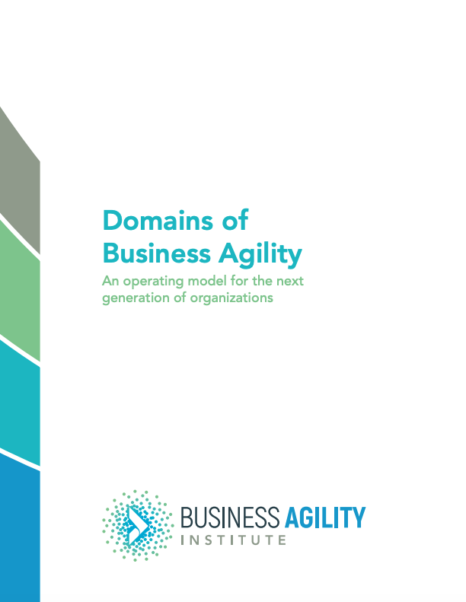
https://businessagility.institute/learn/domains-of-business-agility/
The Domains of Business Agility is licensed by the Business Agility Institute under a Creative Commons Attribution-ShareAlike 4.0 International License
Notes:
Think of the Domains of Business Agility as the “muscles” the organization needs to invest in develop Business Agility . You don’t need to work on all the muscles, but you need to work on the muscles that are weak and the muscles you need for the capabilities you need to develop.

Slide 7
CUSTOMER CENTRIC PURPOSE & IDENTITY
The Domains of Business Agility is licensed by the Business Agility Institute under a Creative Commons Attribution-ShareAlike 4.0 International License
The content of this slide attributed to Ahmed Sidky
Notes:
While Business Agility can be in service of the efficiency and optimization, I think that business agility pursed only in-service of delighting the customer – why because it is just a journey and to sustain that journey the purpose need to be bigger than optimization of the organization itself. A customer-centric purpose (fighting on behalf of an underserved customer) that inspires endurance is what is needed to pursue the long and hard journey of business agility.

Slide 8
/ Board: Business Agility requires an open, 2-way, relationship between an organization’s leaders (C-suite) and the board of directors; built upon customer-focus and long-term success, which enables the company leaders to go after long-term bets, as opposed to short-term wins.
/ Partners: Business Agility thrives with partnerships crafted with flexibility and driven by customer value so both the organization and its partners are able to adapt in a coordinated and complementary manner, rather than a series of contractual transactions.
/ Workforce: Business Agility in service of customer-centricity is built upon a mission-aligned, passionate, empowered workforce…they need to CARE about the customer
FOUNDATIONAL ALIGNMENT THAT ENABLES CUSTOMER CENTRICITY
The Domains of Business Agility is licensed by the Business Agility Institute under a Creative Commons Attribution-ShareAlike 4.0 International License
The content of this slide attributed to Ahmed Sidky
Notes:
Watch https://youtu.be/rLqozl2lmGk for the talk track for this slide

Slide 9
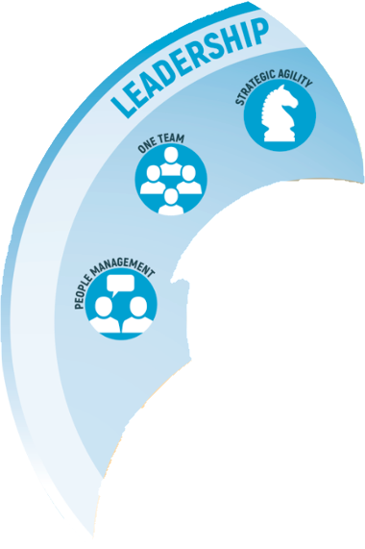
/ Strategic Agility: Business Agility thrives when leaders set, and clearly communicate, an adaptive strategy that empowers teams to identify opportunities to execute that strategy in potentially innovative and previously unforeseen ways.
/ One Team: Business Agility thrives with a One Team mindset. Leaders need to demonstrate this One Team mindset in everything they do. Leaders shouldn’t be building “kingdoms or silos” but rather they are champions of shared goals that span functions, teams, and divisions within the organization to pursue customer delight and value
/ People Management: Business Agility needs leaders to recruit, hire, nurture, and develop people with a strong fit for future potential and mission alignment, over fit for a position. People are looking for an empowered , supportive environment to bring their best selves.
The Domains of Business Agility is licensed by the Business Agility Institute under a Creative Commons Attribution-ShareAlike 4.0 International License
The content of this slide attributed to Ahmed Sidky
Notes:
Watch https://youtu.be/rLqozl2lmGk for the talk track for this slide

Slide 10
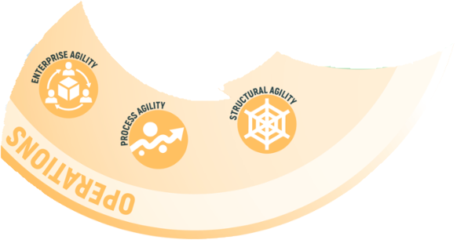
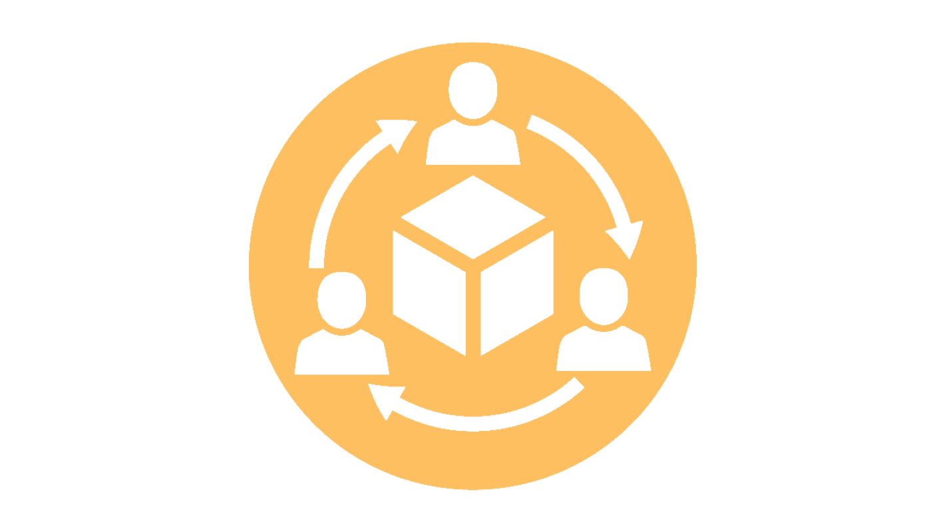
The Domains of Business Agility is licensed by the Business Agility Institute under a Creative Commons Attribution-ShareAlike 4.0 International License
The content of this slide attributed to Ahmed Sidky
/ Process Agility: Business Agility requires operations to adapt and continuously evolve as needed in service of creating value for customers.
/ Structural Agility: Business Agility needs the ability for an organization to create coalitions or change structure as needed to embrace new opportunities with ease and without disruption.
/ Enterprise Agility: Business Agility requires business operations governance frameworks that enable, rather than stifle, individuals and teams pursuing emergent opportunities.
Notes:
Watch https://youtu.be/rLqozl2lmGk for the talk track for this slide

Slide 11
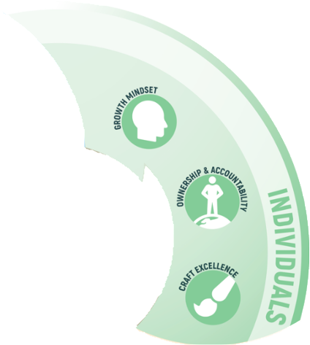
/ Ownership & Accountability: Business Agility needs deep ownership and accountability so individuals close to the work and customers drive timely decision making and adaptations.
/ Growth Mindset: Business Agility requires that individuals are open to learning by doing, continuous learning and personal development as well as being comfortable operating and making decisions in a dynamic and ambiguous environment, free from the fear of failure.
/ Craft Excellence: Business Agility thrives with craft excellence that (a) continually improves over time, (b) is the most impactful to creating value, and (c) enables individuals to take advantage of emergent opportunities for customers.
The Domains of Business Agility is licensed by the Business Agility Institute under a Creative Commons Attribution-ShareAlike 4.0 International License
The content of this slide attributed to Ahmed Sidky
Notes:
Watch https://youtu.be/rLqozl2lmGk for the talk track for this slide

Slide 12
Business agility is a set of organizational capabilities, behaviors, and ways of working that affords your business the freedom, flexibility, and resilience to achieve its purpose. No matter what the future brings.
-The Business Agility Institute
Example Capabilities:
The ability to cultivate a culture of learning and experimentation
The ability to seize emergent opportunities
The ability to adaptively and dynamically fund
The ability to lead through empowerment and influence
Notes:
Watch https://youtu.be/rLqozl2lmGk for the talk track for this slide

Slide 13
Capability: The ability to cultivate a culture of learning and experimentation
Alignment Workforce
Individuals Craft Excellence
Individuals Ownership & Accountability
Individuals Growth Mindset
Leadership People Management
Leadership Strategic Agility
The Domains of Business Agility is licensed by the Business Agility Institute under a Creative Commons Attribution-ShareAlike 4.0 International License
The content of this slide attributed to Ahmed Sidky
Notes:
Watch https://youtu.be/rLqozl2lmGk for the talk track for this slide

Slide 14
Capability: The ability to seize emergent opportunities
Leadership Strategic Agility
Leadership One Team
Individuals Craft Excellence
Operations Structural Agility
Alignment Partners
The Domains of Business Agility is licensed by the Business Agility Institute under a Creative Commons Attribution-ShareAlike 4.0 International License
The content of this slide attributed to Ahmed Sidky
Notes:
Watch https://youtu.be/rLqozl2lmGk for the talk track for this slide

Slide 15
Capability: The ability to adaptively and dynamically fund
Alignment Board
Leadership One Team
Operations Enterprise Agility
Operations Process Agility
The Domains of Business Agility is licensed by the Business Agility Institute under a Creative Commons Attribution-ShareAlike 4.0 International License
The content of this slide attributed to Ahmed Sidky
Notes:
Watch https://youtu.be/rLqozl2lmGk for the talk track for this slide

Slide 16
Capability: The ability to lead through empowerment and influence
Alignment Workforce
Leadership People Management
Individuals Ownership & Accountability
The Domains of Business Agility is licensed by the Business Agility Institute under a Creative Commons Attribution-ShareAlike 4.0 International License
The content of this slide attributed to Ahmed Sidky
Notes:
Watch https://youtu.be/rLqozl2lmGk for the talk track for this slide

Slide 17
https://businessagility.institute/learn/domains-of-business-agility/
The capability to:
adaptively and dynamically fund
lead through empowerment and influence
cultivate a culture of learning and experimentation
seize emergent opportunities
lower the "cost" of change & disruption
strategically & seamlessly evolve structure & operating model
to [hyper] focus the entire organization on what's important
Business agility is a set of organizational capabilities, behaviors, and ways of working that affords your business the freedom, flexibility, and resilience to achieve its purpose. No matter what the future brings.
-The Business Agility Institute

Slide 18
THANK YOU

