Slide 1
Slides to help explaining Agile as mindset

Slide 2
To see how these slides can be used and the narrative I use with these slides please watch:
https://youtu.be/oZ6dPacn4Js

Slide 3
Permissions
The intent for sharing this material is to allow you to use and adapt these slides to help you explain Agile. Please feel free to use and / or modify these slides as needed. I have also included some light speaker notes to help you. Please keep the attribution on the slides.

Slide 4
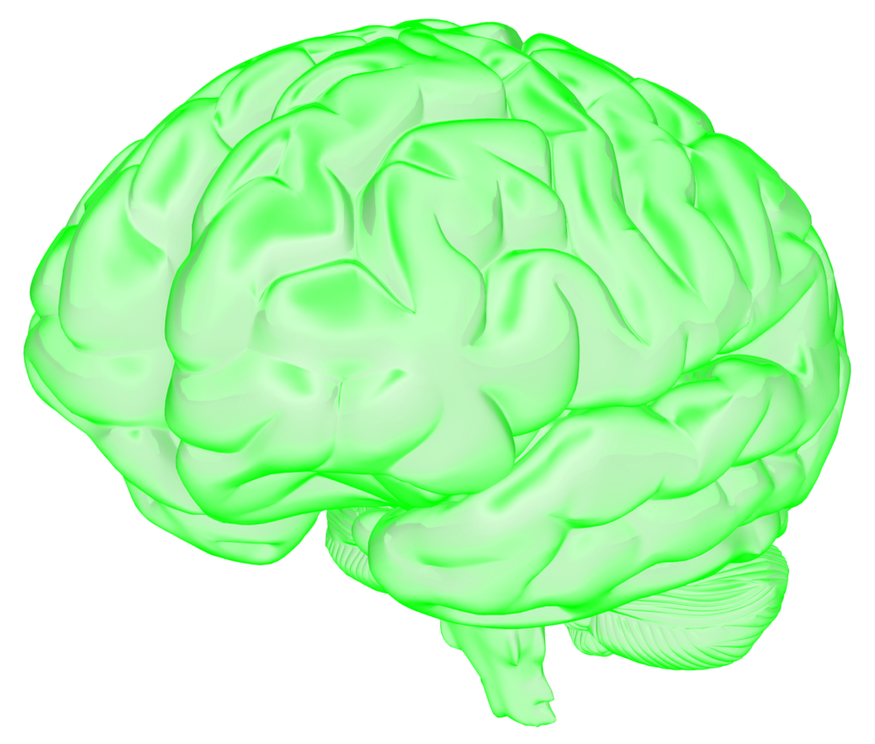
WHAT IS AGILE?
AGILE IS A MINDSET
DESCRIBED BY 4 VALUES
DEFINED BY
12 PRINCIPLES
MANIFESTED THROUGH AN
UNLIMITED NUMBER OF PRACTICES
Mindset
Values
Principles
Practices
Visualization attributed to Ahmed Sidky, ICAgile and Riot Games
Notes:
BOTTOM-LINE: Agile is a Mindset, Guiding Values and Principles that are manifested through an unlimited set of practices
Key Point Cues:
Mindset
Values
Principles
Unlimited Practices
Supporting Points:
Agile is a mindset described by 4 values, defined by 12 principles, manifested through an unlimited number of practices. Talk more about the mindset if you haven’t already. If you need some inspiration watch this video: https://youtu.be/DYNY7zCZPaU
Why do we say, “an UNLIMITED number of practices?” [If there were only ONE way to be agile, that wouldn’t be very agile, would it?]

Slide 5
WHAT IS AGILE?
AGILE IS A MINDSET
DESCRIBED BY 4 VALUES
DEFINED BY
12 PRINCIPLES
MANIFESTED THROUGH AN
UNLIMITED NUMBER OF PRACTICES
SCRUM
XP
Other
Mindset
Values
Principles
Practices
Visualization attributed to Ahmed Sidky, ICAgile and Riot Games
Notes:
BOTTOM-LINE: Frameworks are a way to execute in an Agile manner; (Scrum <> Agile)
Key Point Cues:
Approach Agile From the Mindset
Frameworks are ways to execute in an agile manner
Scrum and XP are widely known
Don’t get stuck in one framework
Be agile about your agile process
Supporting Points:
If you come at it from the mindset, as long as you are respecting the values and be guided by the principles you can pull together any practices that make sense for your organization.
Further more, you can continue to inspect and adapt those practices as you learn more. Just like we get frequent feedback to adapt our product, we can do the same with our agile process.
Just to define some common terms, Scrum and XP are two agile Frameworks that are among those most widely used in the industry
Scrum is a project management framework for executing product development in an agile manner and it consists of 6 primary practices,
XP, or Extreme Programming, consists of 12 practices and focuses generally on technical practices. You will often see teams combining both Scrum and XP practices on Agile projects

Slide 6
WHAT IS AGILE?
AGILE IS A MINDSET
DESCRIBED BY 4 VALUES
DEFINED BY
12 PRINCIPLES
MANIFESTED THROUGH AN
UNLIMITED NUMBER OF PRACTICES
BEING
AGILE
DOING
AGILE
Mindset
Values
Principles
Practices
Visualization attributed to Ahmed Sidky, ICAgile and Riot Games
Notes:
BOTTOM LINE: Approach agility from the being, not the doing to achieve sustainable agility
Key Word Cues:
What is Being vs. Doing?
Risk of “Doing” is getting “Stuck in Shu”
Being allows you to be agile about your agile process
Supporting Points:
What is the difference between “being” agile and “doing” agile? Can you be “doing” Scrum and not “be” agile?”
The danger of approaching from the side of doing vs being agile is that you put together a collection of practices, the minute that those practices don’t meet your needs and you don’t have the essence or the being side, you’re stuck.
Just like the learning journey of Shu Ha Ri [Here is a video on Shu Ha Ri: https://youtu.be/owF2_QcrspE], we want to focus on the underlying mindset and principles so we don’t get stuck in Shu
We want to journey towards Ri by adopting an agile mindset and tailor our processes and practices to our reality.

Slide 7
 | 9 AM | 10 AM | 11 AM | 12 PM | 1 PM | 2 PM | 3 PM | 4 PM
Day 1
Day 2
Day 3
Day 4
Day 5
Day 6
Day 7
Day 8
Day 9
Day 10
Other
BEING
AGILE
VS
A Typical 2-Week Iteration for a Team
DOING
AGILE
Iteration Planning
Stand-up
Demo
Retrospective
Release Planning
Visualization attributed to Ahmed Sidky, ICAgile and Riot Games
Notes:
BOTTOM-LINE: The “Doing” is the execution of the practices – this is a relatively small % of time.
Key Point Cues:
Typical 2-week sprint
Practices shown here
This is the Doing
Supporting Points:
So here is a typical '2-week sprint' of work for a team
You can see the 10 days of work, and the hours through the day for standard meetings like standups and planning
This is essentially the “doing” of agile in terms of the agreed upon practices

Slide 8
 | 9 AM | 10 AM | 11 AM | 12 PM | 1 PM | 2 PM | 3 PM | 4 PM
Day 1
Day 2
Day 3
Day 4
Day 5
Day 6
Day 7
Day 8
Day 9
Day 10
Other
BEING
AGILE
VS
BEING
AGILE
A Typical 2-Week Iteration for a Team
DOING
AGILE
Iteration Planning
Stand-up
DOING AGILE
Demo
Retrospective
Release Planning
Visualization attributed to Ahmed Sidky, ICAgile and Riot Games
Notes:
BOTTOM-LINE: Be agile while doing agile
Key Point Cues:
BE Agile
Supporting Points:
The meetings are where you 'do agile', the rest of the time you need to 'be agile’
The practices are one thing to know, but being agile is how you think and behave.
How you and your team interact in the spaces between the scheduled practices and ceremonies matters most
Engage your audience: Ask: What are behaviors that show people are when they are “Being Agile” – that is what Agile is about – the behaviors and mindset that changes in people not the rituals and practices

