Slide 1
CULTURE-LED
Agile TRANSFORMATION
Notes:
Watch https://www.youtube.com/watch?v=qNmL08RwFcc to see how I talk about this subject

Slide 2
To see how these slides can be used and the narrative I use with these slides please watch:
https://www.youtube.com/watch?v=qNmL08RwFcc

Slide 3
Permissions
The intent for sharing this material is to allow you to use and adapt these slides to help you explain Culture-led transformation. Please feel free to use and / or modify these slides as needed. I have also included some light speaker notes to help you.
Please keep the attribution on the slides.
Culture Triangle model attributed to Ahmed Sidky

Slide 4
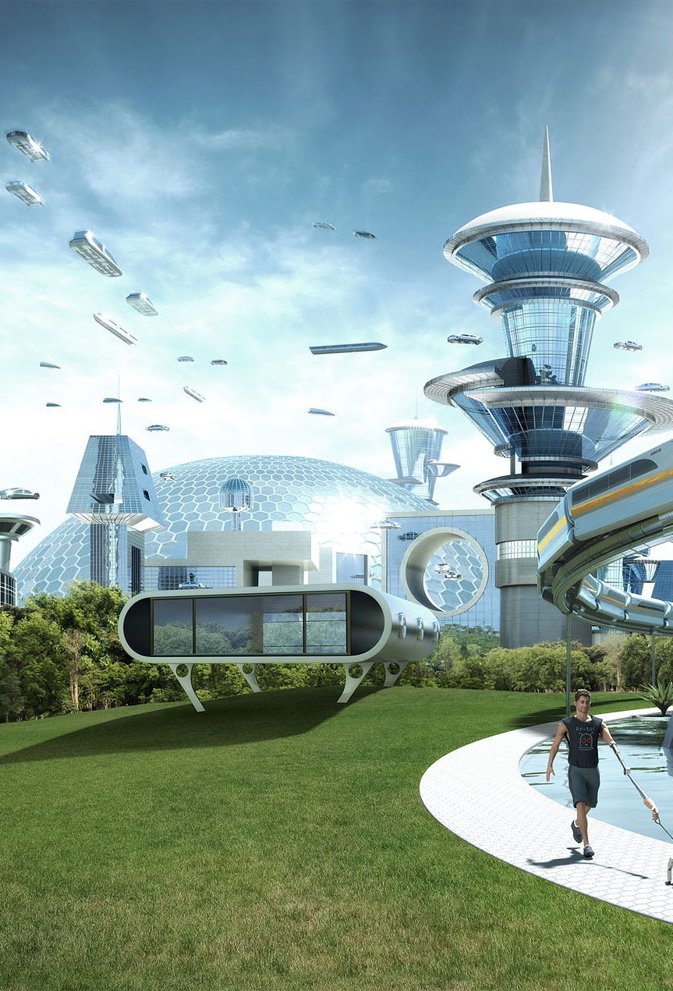
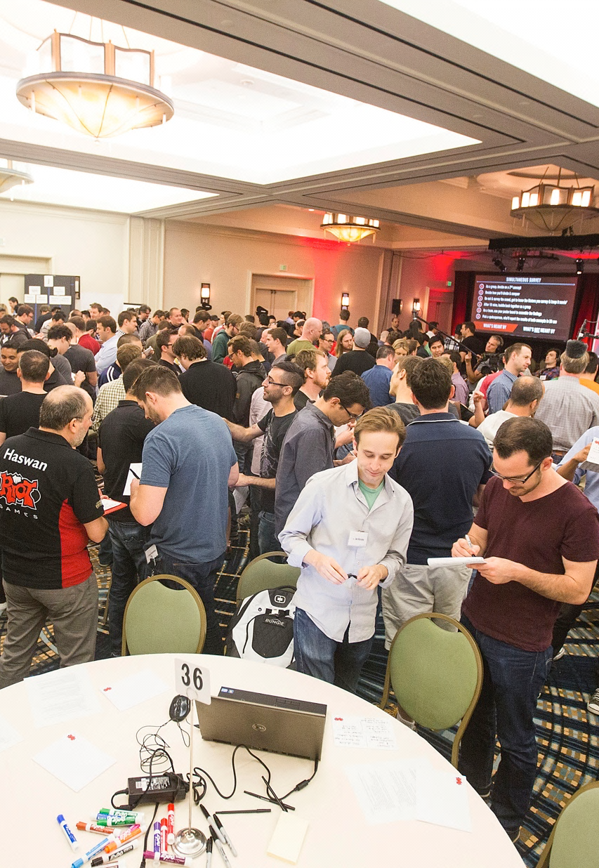
SHU LEVEL RECIPE FOR AGILE TRANSFORMATION
1
2
3
VISION
OUTCOMES
CULTURE
Culture-led transformation and the content of this slide attributed to Ahmed Sidky
Notes:
Watch https://www.youtube.com/watch?v=qNmL08RwFcc to see how I talk about this subject

Slide 5
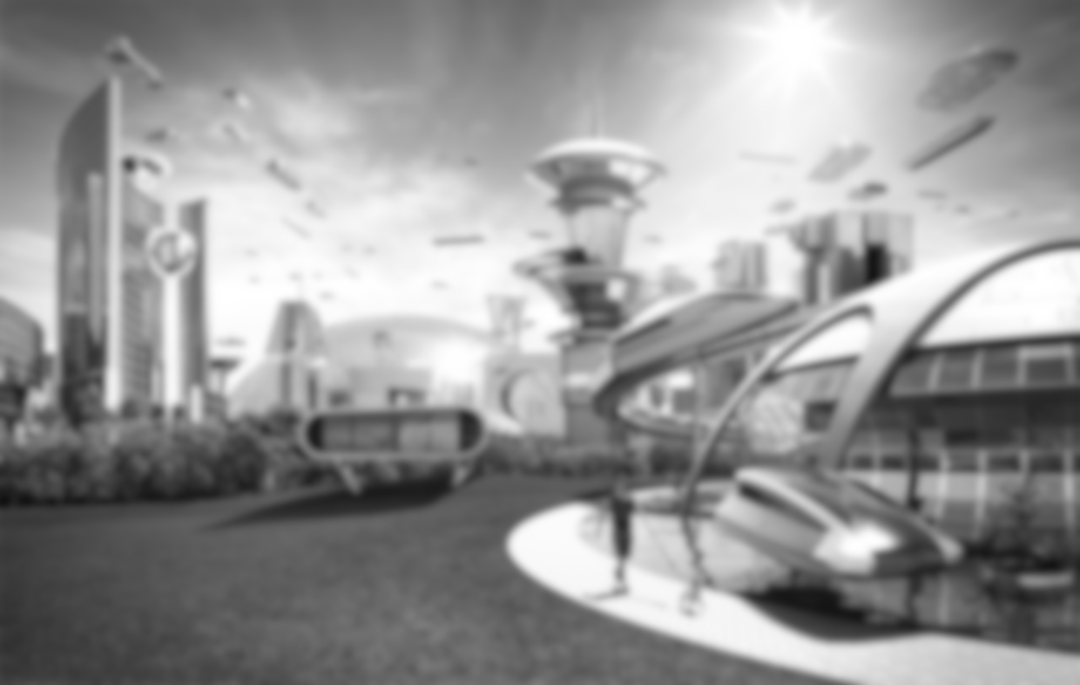
STEP1: CREATE A INSPIRING VISION FOR THE TRANSFORMATION
INSPIRE THE HEARTS AND MINDS
Notes:
Watch https://www.youtube.com/watch?v=qNmL08RwFcc to see how I talk about this subject

Slide 6

Vision is a clearly-articulated, results-oriented picture of a future you intend to create. It is a dream with direction.
Notes:
Watch https://www.youtube.com/watch?v=qNmL08RwFcc to see how I talk about this subject

Slide 7
Company ABC – Agile Transformation Vision
Vision Statement
A unified global team. Delivering A DELIGHTFUL EXPERIENCE. Everyday.
Vivid Descriptions
Silos are no longer tolerated…we are one team across the globe...collaboration is in our DNA.
We will invest time to collaborate together. Teams will feel energized because they “get” to work with other teams, instead of “have” to work with them. And while collaboration may be hard and many times messy, it will also be exciting and invigorating. Our energy to work together comes from knowing we can, and will, deliver a bold new world for our customers. We will do the impossible for our them and challenge anyone who says we can’t do it. Trying to just get “more things out of the door” will be a thing of the past and we will ruthlessly prioritize the work that will bring the most value and delight to our customers.
Our workplace feels different than anywhere else. We feel safe to learn through failure. We are brave enough to experiment. We are agile enough to change daily. We are humble enough to listen to feedback. Everything just works …there is no noise -- anywhere! Just energy --- everywhere!
Desired Areas of Impact:
(1) Collaboration across Silos, (2) Customer Centricity, (3) Culture of Learning
Culture-led transformation and the content of this slide attributed to Ahmed Sidky
Notes:
Watch https://www.youtube.com/watch?v=qNmL08RwFcc to see how I talk about this subject

Slide 8

STEP 2: Identify Outcomes
GO DEEP TO UNDERSTAND BEHAVIORAL CHANGE
Notes:
Watch https://www.youtube.com/watch?v=qNmL08RwFcc to see how I talk about this subject

Slide 9

Vision: A unified global team. Delivering a delightful experience. Everyday.
Output
Outcome
Impact
A “thing” produced and delivered to an audience.
The behavioral change(s) that occur in a member or members of the audience.
Big systemic changes that need to happen to realize the vision, resulting from outcomes at scale.
Culture-led transformation and the content of this slide attributed to Ahmed Sidky
Notes:
Watch https://www.youtube.com/watch?v=qNmL08RwFcc to see how I talk about this subject

Slide 10
Vision: A unified global team. Delivering a delightful experience. Everyday.
Output
Outcome
Impact
Collaboration across Silos
Leaders operate as a single team and not from a siloed mindset
A “thing” produced and delivered to an audience.
The behavioral change(s) that occur in a member or members of the audience.
Big systemic changes that need to happen to realize the vision, resulting from outcomes at scale.
Culture-led transformation and the content of this slide attributed to Ahmed Sidky
Notes:
Watch https://www.youtube.com/watch?v=qNmL08RwFcc to see how I talk about this subject

Slide 11
Vision: A unified global team. Delivering a delightful experience. Everyday.
Output
Outcome
Impact
People reach outside their departments and business units to help each other when working on common goals
Collaboration across Silos
Leaders operate as a single team and not from a siloed mindset
A “thing” produced and delivered to an audience.
The behavioral change(s) that occur in a member or members of the audience.
Big systemic changes that need to happen to realize the vision, resulting from outcomes at scale.
Culture-led transformation and the content of this slide attributed to Ahmed Sidky
Notes:
Watch https://www.youtube.com/watch?v=qNmL08RwFcc to see how I talk about this subject

Slide 12
Vision: A unified global team. Delivering a delightful experience. Everyday.
Outcome
Output
Outcome
Impact
Team members take initiative and do things outside of their defined role instead of complaining, blaming others, giving excuses or saying “someone should do this …”
Collaboration across Silos
Leaders operate as a single team and not from a siloed mindset
A “thing” produced and delivered to an audience.
The behavioral change(s) that occur in a member or members of the audience.
Big systemic changes that need to happen to realize the vision, resulting from outcomes at scale.
Culture-led transformation and the content of this slide attributed to Ahmed Sidky
Notes:
Watch https://www.youtube.com/watch?v=qNmL08RwFcc to see how I talk about this subject

Slide 13
Vision: A unified global team. Delivering a delightful experience. Everyday.
Outcome
Output
Outcome
Impact
Senior leaders make only the most critical decisions. Most decisions is pushed down into the org. Senior leaders empower and encourage decision making of other.
Customer Centricity
We focus on holistic customer experiences that span multiple silos while keeping decision making clear and fast. There needs to be a strong sense of ownership at the frontline closest to the customer
A “thing” produced and delivered to an audience.
The behavioral change(s) that occur in a member or members of the audience.
Big systemic changes that need to happen to realize the vision, resulting from outcomes at scale.
Culture-led transformation and the content of this slide attributed to Ahmed Sidky
Notes:
Watch https://www.youtube.com/watch?v=qNmL08RwFcc to see how I talk about this subject

Slide 14
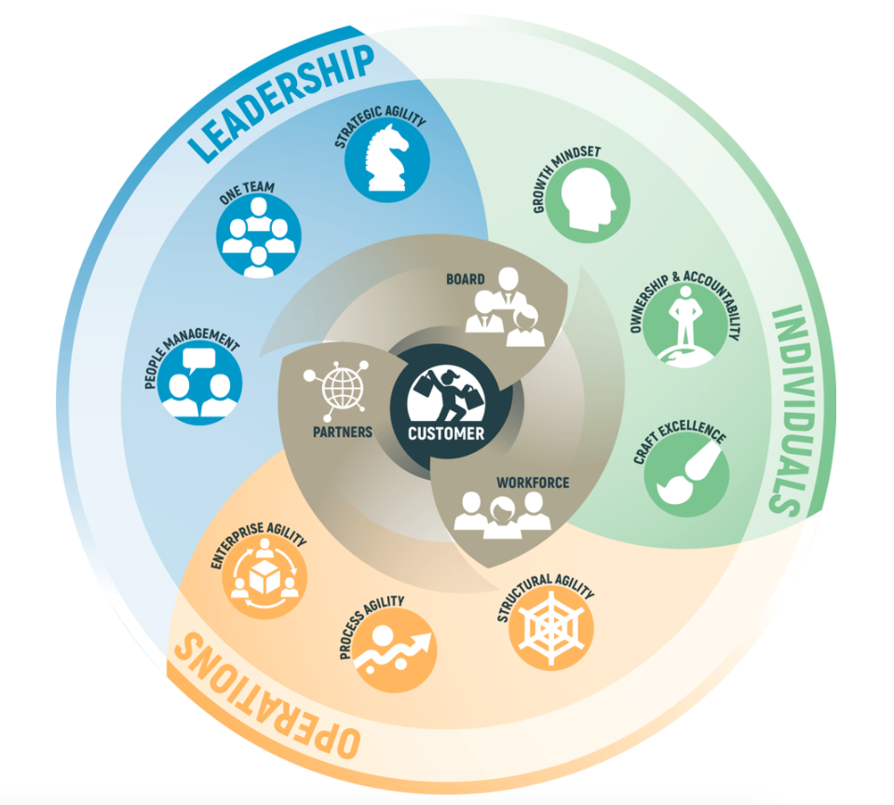
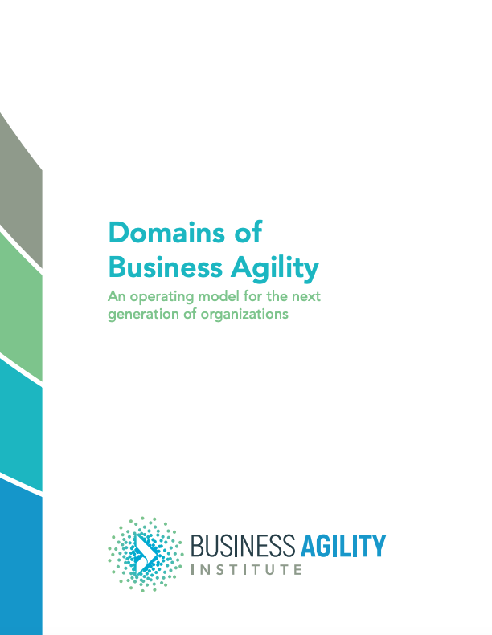
Recommendation: Regardless if you or your organization is a member of the Business Agility Institute (BAI), I reading through the Domains of Business Agility. They can be a great inspiration for what kind of behaviors to aspire to have in your organization as you pursue your journey of agility.
https://businessagility.institute/learn/domains-of-business-agility/
Notes:
Watch https://www.youtube.com/watch?v=qNmL08RwFcc to see how I talk about this subject

Slide 15
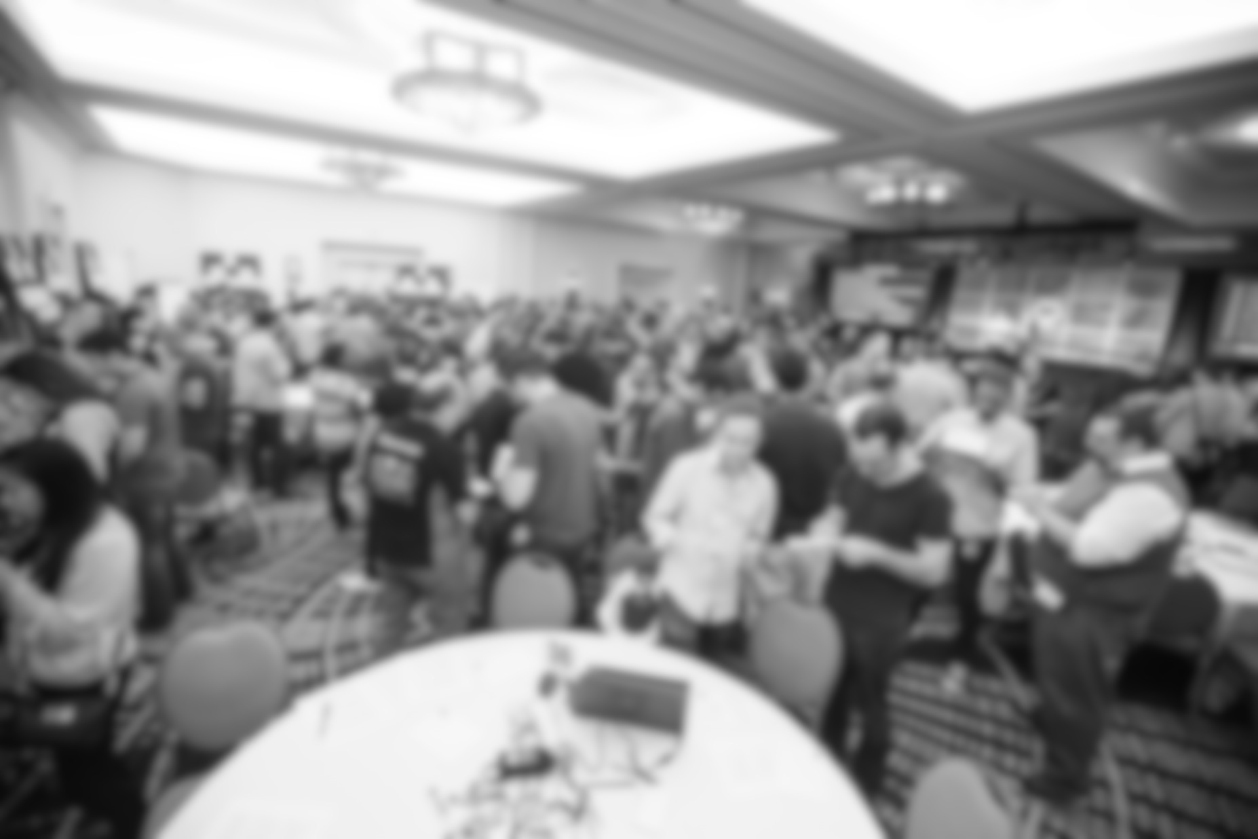
STEP 3: CRAFT A CULTURE TRANSFORMATION ROADMAP
FOCUS ON THE HOLISTIC CULTURE
Notes:
Watch https://www.youtube.com/watch?v=qNmL08RwFcc to see how I talk about this subject

Slide 16
Vision: A unified global team. Delivering a delightful experience. Everyday.
Outcome
Output
Outcome
Impact
Senior leaders make only the most critical decisions. Most decisions is pushed down into the org. Senior leaders empower and encourage decision making of other.
Customer Centricity
We focus on holistic customer experiences that span multiple silos while keeping decision making clear and fast. There needs to be a strong sense of ownership at the frontline closest to the customer
A “thing” produced and delivered to an audience.
The behavioral change(s) that occur in a member or members of the audience.
Big systemic changes that need to happen to realize the vision, resulting from outcomes at scale.
Culture-led transformation and the content of this slide attributed to Ahmed Sidky
Notes:
Watch https://www.youtube.com/watch?v=qNmL08RwFcc to see how I talk about this subject

Slide 17
COMPONENTS OF CULTURE
Culture-led transformation and the content of this slide attributed to Ahmed Sidky
Notes:
Watch https://www.youtube.com/watch?v=qNmL08RwFcc to see how I talk about this subject

Slide 18
Area of desired impact:
Collaboration across Silos
Leaders operate as a single team and not from a siloed mindset
Desired behavioral changes
People reach outside their departments and business units to help each other when working on common goals
Team members take initiative and do things outside of their defined role instead of complaining, blaming others, giving excuses or saying “someone should do this …”
 | Leadership mindset | habits | values | Strategy goals | measures | rewards | Structure roles | design| models | Process workflow | ops | policies | People mindset | habits | norms
Collaboration across Silos | Output: Things to change | Output: Things to change | Output: Things to change | Output: Things to change | Output: Things to change
Culture-led transformation and the content of this slide attributed to Ahmed Sidky
Notes:
Watch https://www.youtube.com/watch?v=qNmL08RwFcc to see how I talk about this subject

Slide 19
Area of desired impact:
Collaboration across Silos
Leaders operate as a single team and not from a siloed mindset
Desired behavioral changes
People reach outside their departments and business units to help each other when working on common goals
Team members take initiative and do things outside of their defined role instead of complaining, blaming others, giving excuses or saying “someone should do this …”
 | Leadership mindset | habits | values | Strategy goals | measures | rewards | Structure roles | design| models | Process workflow | ops | policies | People mindset | habits | norms
Collaboration across Silos | Workshops / Learning Exec Coaching Facilitated Interventions | Changes in systems, measures, goals, rewards | New Roles New Org Design New Team Structures | New Practices New Workflows New Processes | Workshops / Learning Mentoring / Coaching Facilitated Interventions
Culture-led transformation and the content of this slide attributed to Ahmed Sidky
Notes:
Watch https://www.youtube.com/watch?v=qNmL08RwFcc to see how I talk about this subject

Slide 20
 | Leadership mindset | habits | values | Strategy goals | measures | rewards | Structure roles | design| models | Process workflow | ops | policies | People mindset | habits | norms
ANOTHER AREA OF DESIRED IMPACT | Workshops / Learning Exec Coaching Facilitated Interventions | Changes in systems, measures, goals, rewards | New Roles New Org Design New Team Structures | New Practices New Workflows New Processes | Workshops / Learning Mentoring / Coaching Facilitated Interventions
Culture of Learning | Workshops / Learning Exec Coaching Facilitated Interventions | Changes in systems, measures, goals, rewards | New Roles New Org Design New Team Structures | New Practices New Workflows New Processes | Workshops / Learning Mentoring / Coaching Facilitated Interventions
Customer Centricity | Workshops / Learning Exec Coaching Facilitated Interventions | Changes in systems, measures, goals, rewards | New Roles New Org Design New Team Structures | New Practices New Workflows New Processes | Workshops / Learning Mentoring / Coaching Facilitated Interventions
Collaboration across Silos | Workshops / Learning Exec Coaching Facilitated Interventions | Changes in systems, measures, goals, rewards | New Roles New Org Design New Team Structures | New Practices New Workflows New Processes | Workshops / Learning Mentoring / Coaching Facilitated Interventions
Culture-led transformation and the content of this slide attributed to Ahmed Sidky
Notes:
Watch https://www.youtube.com/watch?v=qNmL08RwFcc to see how I talk about this subject

Slide 21
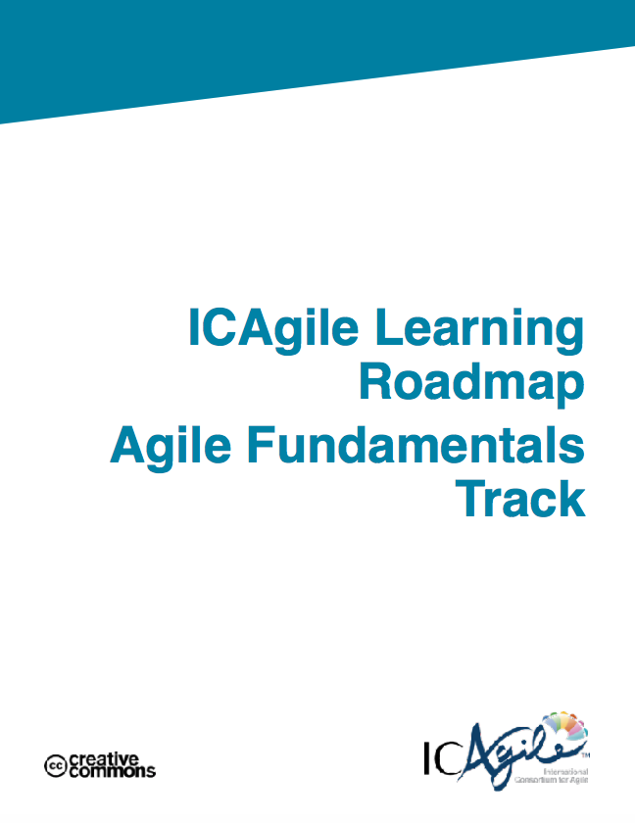
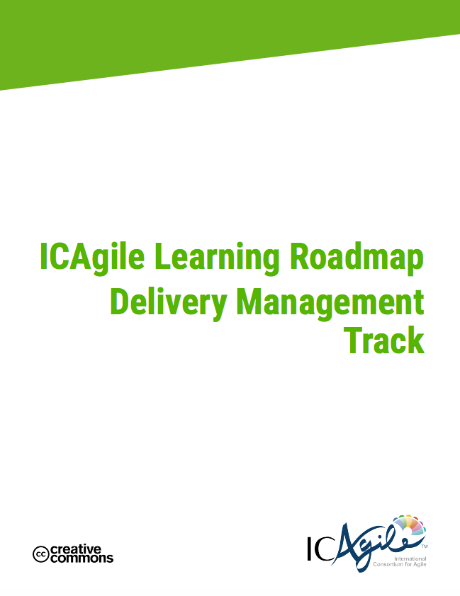
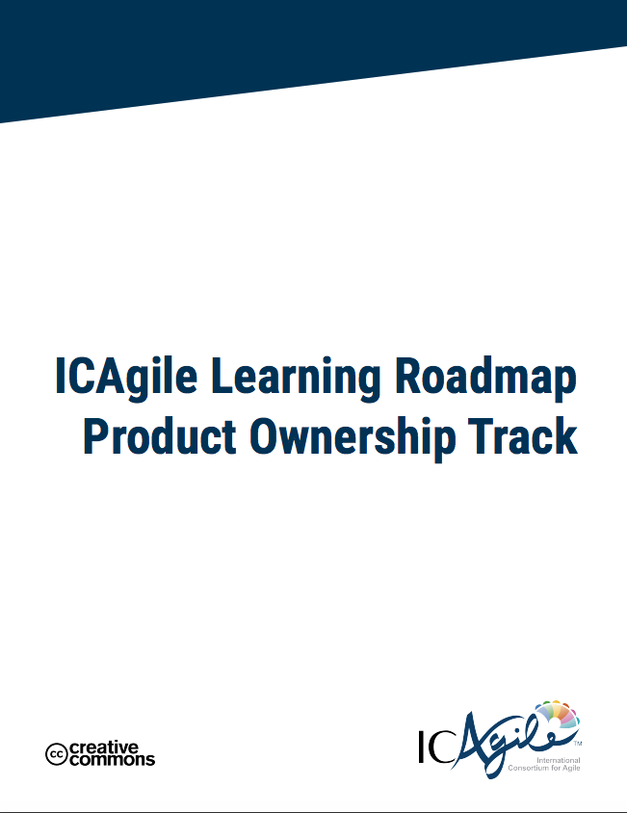
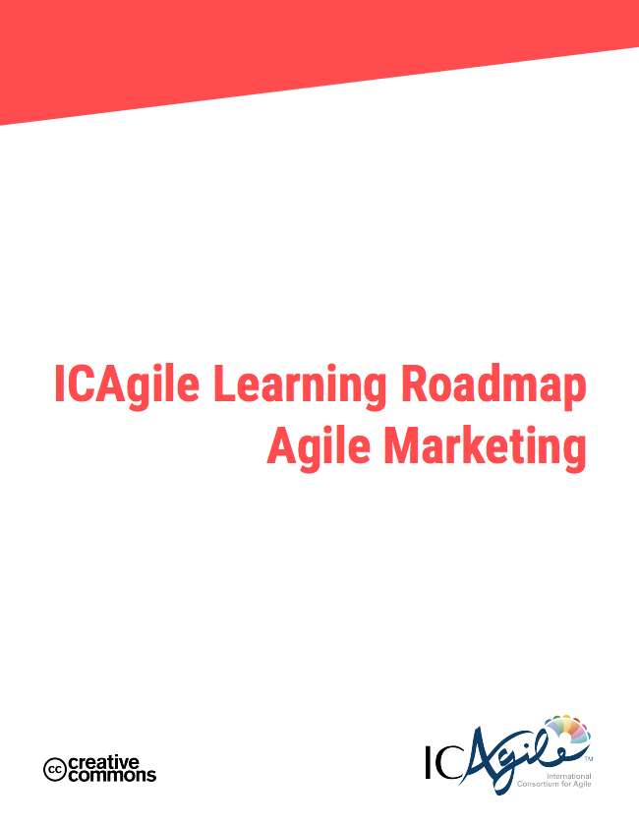

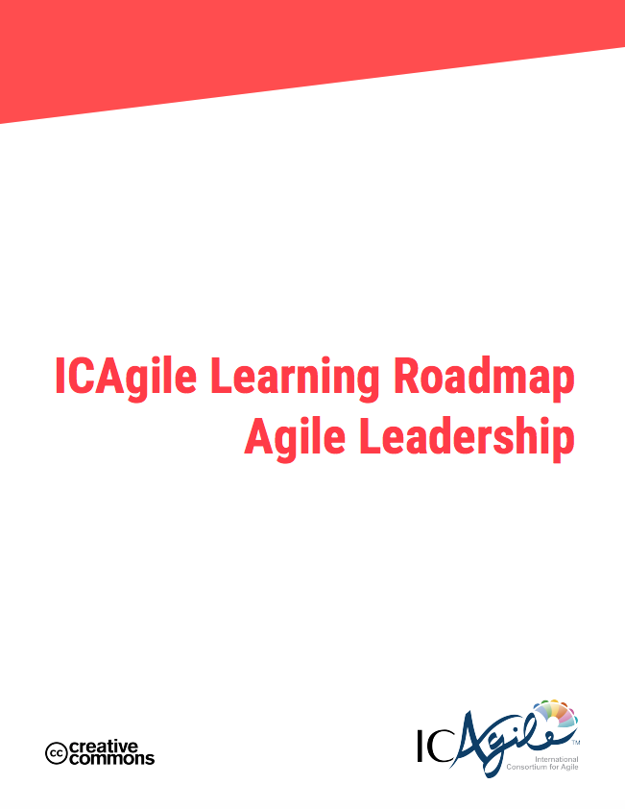
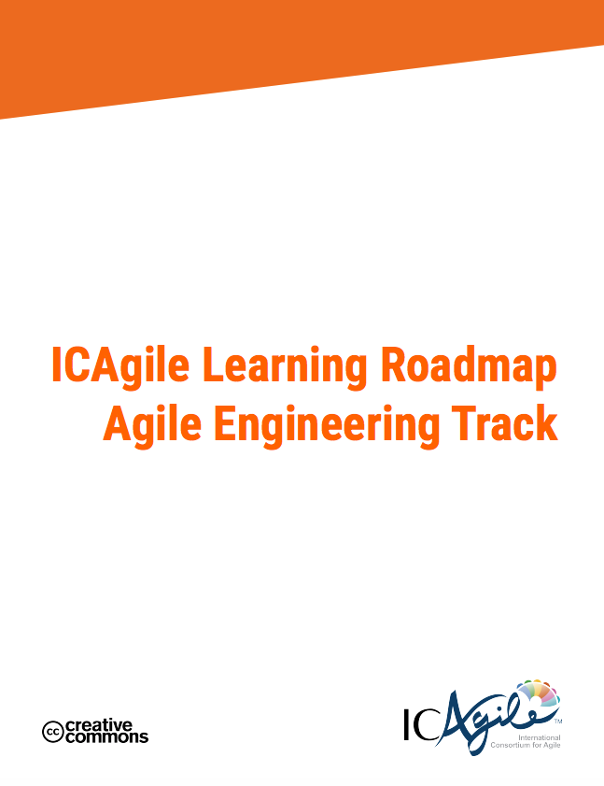
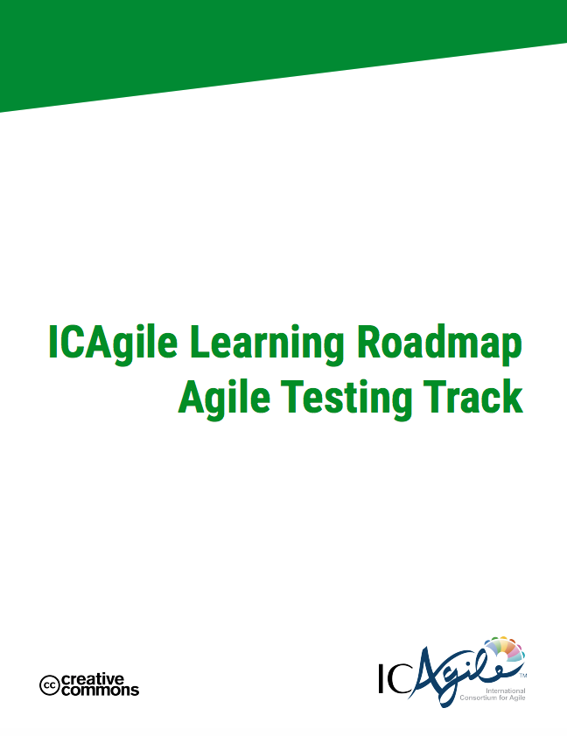
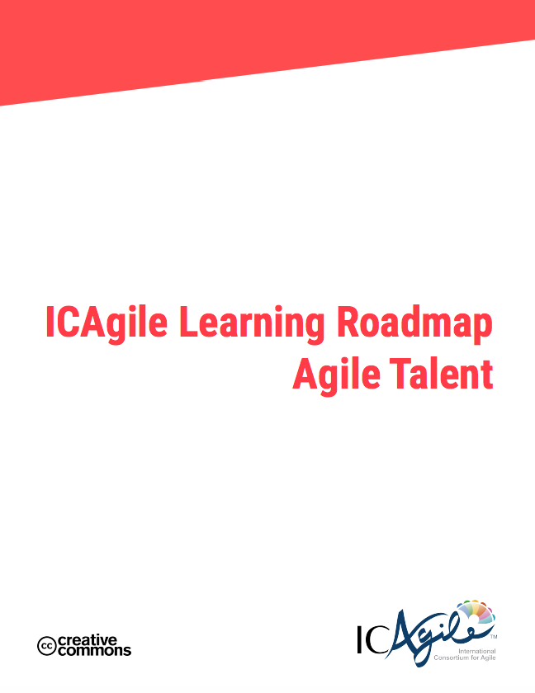
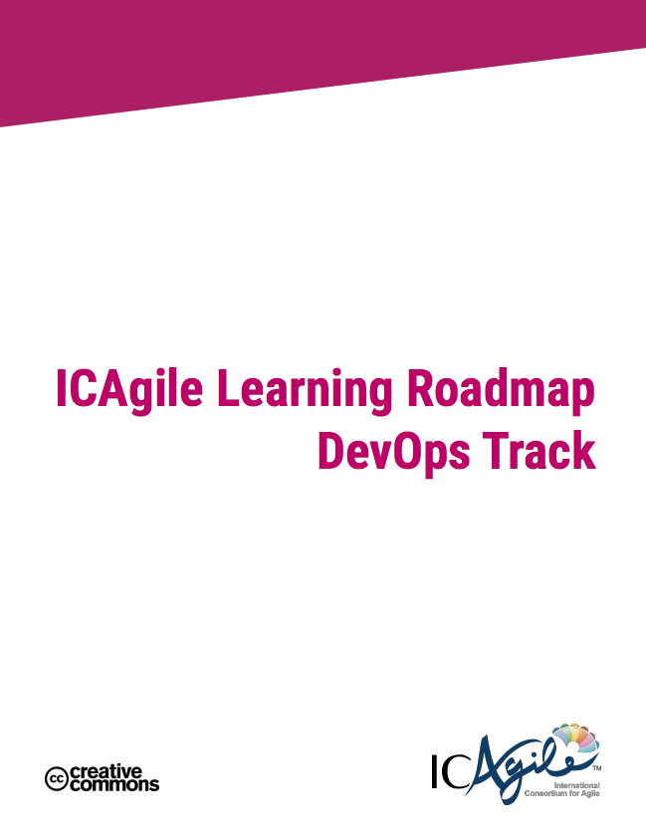
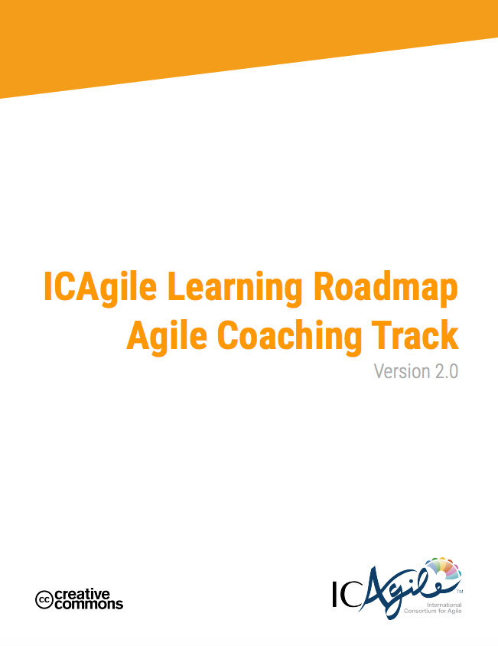
Recommendation: Regardless if you pursue ICAgile’s certification paths, I recommend using ICAgile’s learning tracks and learning outcomes to understand what people and different roles need to learn to help them become agile in their role / craft. This will be very helpful as you design your transformation roadmap for the leadership and people dimensions of Culture.
www.ICAgile.com
Notes:
Watch https://www.youtube.com/watch?v=qNmL08RwFcc to see how I talk about this subject

